Slide 1
Mobile Communication Systems
Introduction
Notes:
1

Slide 2
Contact
Prof. Angela Doufexi
Email: a.doufexi@bristol.ac.uk

Slide 3
Structure
Performance of communication systems
Radiowave Propagation
Cellular Principles and Design
Diversity

Slide 4


Communication System
Transmitter
Information Source
Encoding,
Modulation, Multiplexing
Wireless
channel
Receiver
Estimation of Information Source
Decoding,
Demodulation, Demultiplexing
Interference and noise
Performance of different modulation schemes under AWGN

Slide 5
Radiowave Propagation
To understand shadowing & explain how suitable mathematical models are derived
To explain the basic ideas behind multipath propagation
To define Rayleigh and Rican amplitude and phase variations
To introduce frequency selective fading, power delay profiles, rms delay spread, coherence bandwidth and intersymbol interference
To be able to compute the rms delay spread

Slide 6
Digital Modulation and Diversity
To be able to explain the difference between switched and selection diversity
To appreciate the advantages of equal gain and maximal ratio combining
To be able to explain how diversity can improve performance in narrowband and wideband channels

Slide 7
Cellular Principles and Design
To understand how continuous coverage can be achieved
To be able to explain frequency re-use, handover and cluster size
To understand the relationship between C/I and cluster size
To understand the relationship between cellular capacity and cellular coverage
To appreciate how microcells can increase capacity

Slide 8
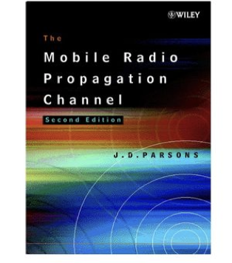
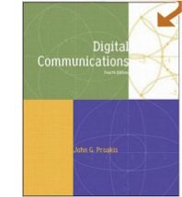
Books (1)
The Mobile Radio Propagation Channel, 2nd Edition J. D. Parsons, October 2000.
ISBN: 978-0-471-98857-1 (436 pages)
This book focuses on the mobile radio channel. It is very relevant for part 1 of this unit. It is probably best to borrow this book from the library as required.
Digital Communications, 4th Edition, McGraw-Hill, John Proakis, December 2000. (Also 5th edition-2007)
ISBN: 0071181830 (1024 pages)
Covers material relevant to parts 1 and 2 of this unit. An excellent standard reference used all over the world. It is very mathematical and not recommended to initially understand new areas. Highly recommended for those planning a career in the mobile communications industry, or for those considering further postgraduate study.

Slide 9
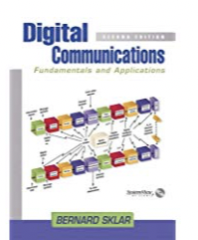
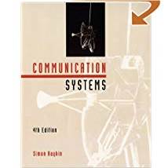
Books (2)
Digital Communications: Fundamentals and Applications, 2nd Edition, Pentice Hall, Bernard Sklar, January 2001
ISBN: 0130847887 (1070 pages)
An excellent entry level book covering parts 1 and 2 of this unit. Much easier to understand than Proakis.
Commuinication Systems, 4th Edition, John Wiley, Simon Haykin, June 2000. (Also 5th edition-2010)
ISBN: 0471178691 (816 pages)
An excellent entry level book covering parts 1 and 2 of this unit. Strongly recommended for anyone interested in wireless communications. A very popular course book for US universities.

Slide 10
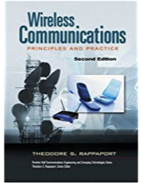
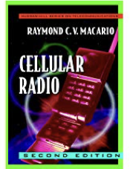
Books (3)
Wireless Communications: Principles and Practice, Prentice Hall, Theodore S. Rappaport, December 2001.
ISBN: 0130422320 (736 pages)
This book has been recommended by previous students.
Cellular Radio, 2nd Edition, R. C. V. MacArio, April 1997.
ISBN: 0070444331 (276 pages)
This book covers the material in part 3 of the unit. This book is not recommended for personal purchase unless you find this part of the unit difficult.

Slide 11
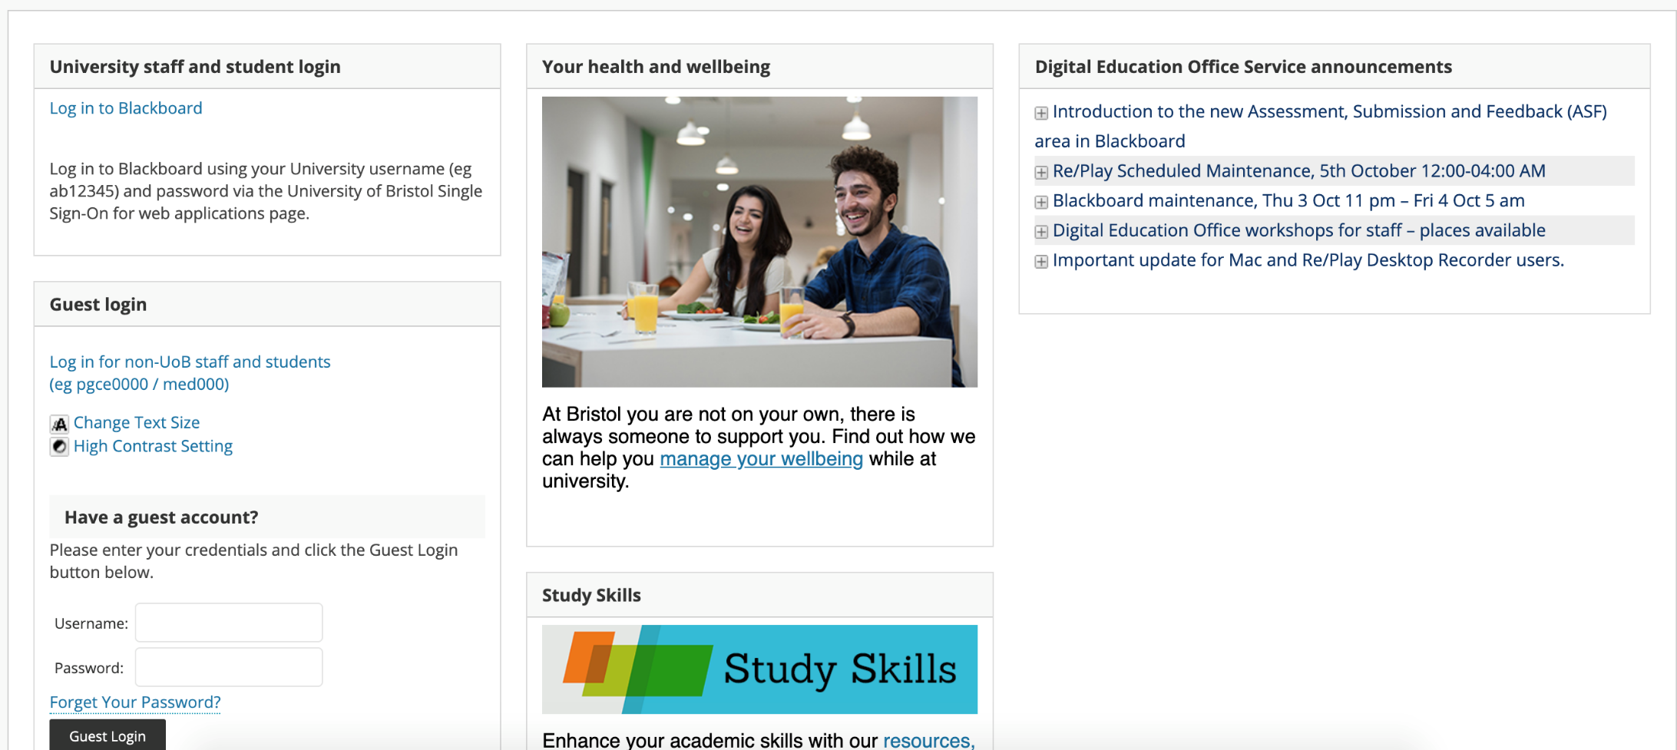
Blackboard
https://www.ole.bris.ac.uk

Slide 12
Performance of Communication Systems
Performance assessment of voice or data link over a real channel
Wire
Wireless
Point-to-point link
Satellite
Cellular (3G-5G, LTE)
WLAN
Radio, TV broadcasting

Slide 13
The Channel
Characteristics
Noise
Fading
Other spectrum users
Rayleigh Fading Channels in Mobile Digital Communication Systems
Bernard Sklar, IEEE Communications Magazine

Slide 14
Performance Measures
Quantitative
Signal to Noise Radio (SNR)
Bit Error Rate (BER)
Packet Error Rate (PER)
Qualitative
Subjective Testing

Slide 15
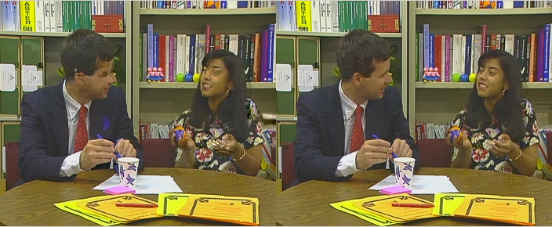
Subjective Testing Example
Subjective quality results, “Paris” sequence, PER = 4% (E_{b}/N₀=28dB).

Slide 16
Quality of Service
Performance Requirements (User’s Application)
Availability & Reliability
Cost of Channel Assess
Cost of Equipment
Quality of Service

Slide 17
Noise in Communication Systems – A Review
Noise: Any spurious signal that masks or obscures the information
Signal to Noise Ratio (SNR) =
Usually expressed in dBs
Relationship between SNR and signal bandwidth (B)
Signal Power
Noise Power

Slide 18
The Shannon Capacity Theorem
The Shannon Capacity Theorem determines the Capacity of a channel where the only form of distortion is AWGN. The capacity of a link, C, is the maximum data rate which it will support.

Slide 19
The Shannon Curve
30
f_{d}/B, Bandwidth Efficiency
20
f_{d} > C
10
Boundary,
f_{d}=C
Error Free Region, f_{d}<C
-1.6
1
E_{b}/N₀ dB
0
6
12
18
24
30
36
0.1

Slide 20
Thermal Noise
Bandwidth (Hz)
Noise Power (W), P = k T B
n
Boltzmann’s Constant 1.38 x 10 J K
Temperature (K)
-23
-1
Often written as:
P = N B
n
Single-sided noise power spectral density
0

Slide 21
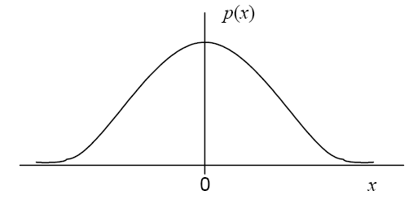

White Noise
Power spectral density is independent of frequency
Also known as Additive White Gaussian Noise AWGN
P(f)
-f
+f

Slide 22
Filtered or Coloured Noise
Bandpass
N /2
0
B
B
Usually a narrowband filter whose bandwidth is large enough to pass the signal is used
The noise appearing at the output of such filter is called narrowband noise

Slide 23
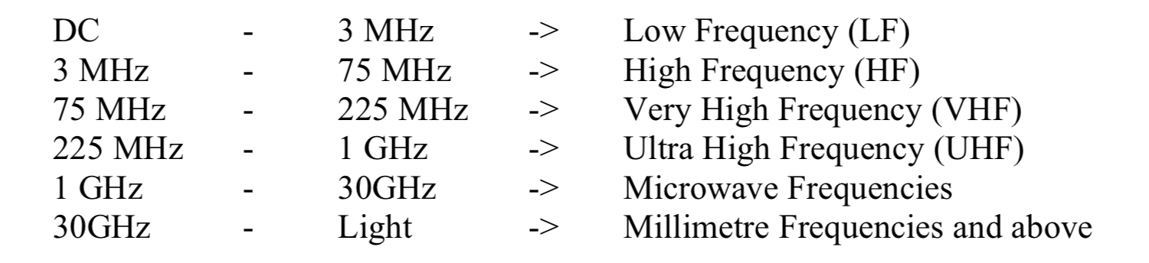
Mobile/Personal Communications
On the move communications
Mobile services depend on radio spectrum availability
Operating frequency affects quality and type of service offered
Frequency bands:

Slide 24
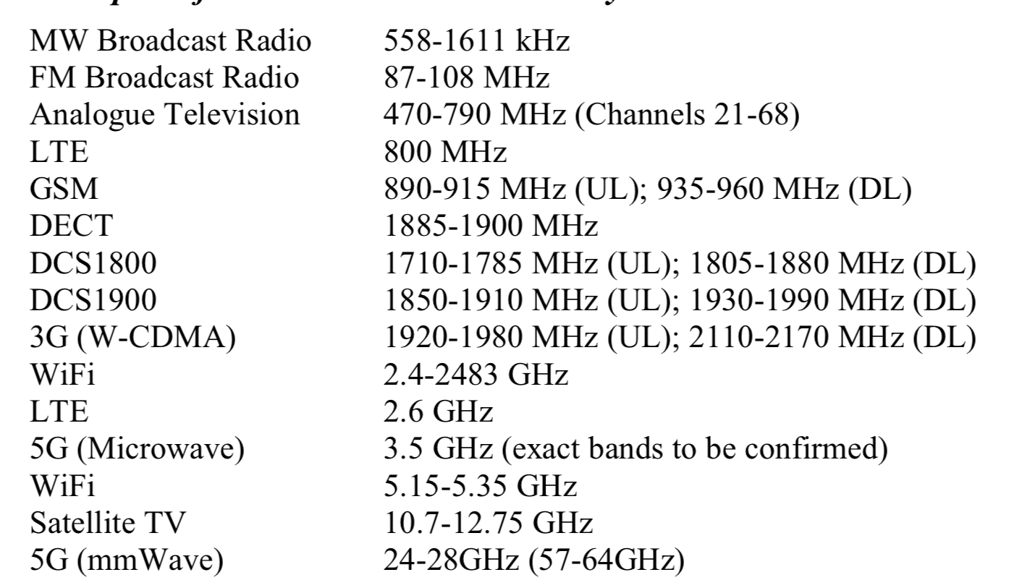
Wireless Communication Systems (1)
Global System
for Mobile communications
Digitally Enhanced Cordless Communications
Long Term
Evolution

Slide 25
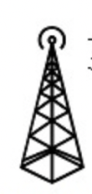

Wireless Communication Systems (2)
Uplink (UL): communication from
handset to basestation
Downlink (DL): communication from basestation to handset

Slide 26
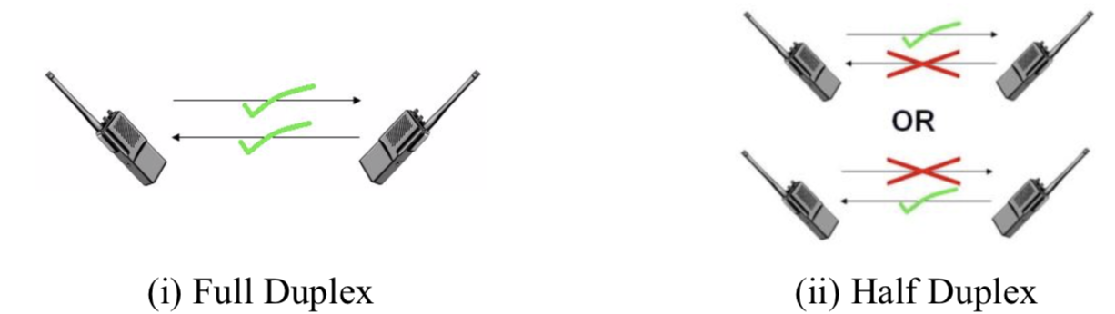
Wireless Communication Systems (4)
Full Duplex:
System is able to transmit and receive
at the same time
Half Duplex:
System that transmits and receives, but not at the same time

Slide 27
Wireless Communication Systems (5)
Frequency Division Duplex (FDD):
Tx and Rx operate at different frequencies
(spaced ~40MHz apart to avoid interference)
and can operate at the same time
Time Division Duplex (TDD):
Tx and Rx operate at same frequencies
allowing one way communication, ie.
Tx and Rx transmit at different times
!!! Do not confuse with FDMA and TDMA --- how users share spectrum

Slide 28
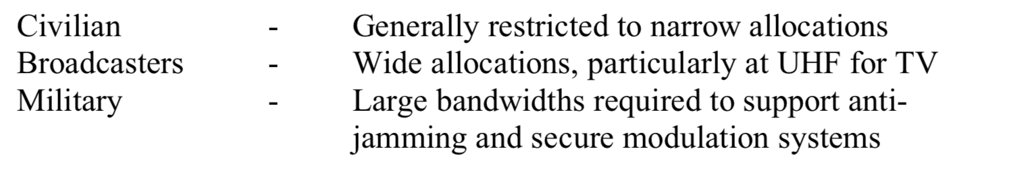
Frequency allocation
Multi-band phones to support different frequency bands
Multi-mode phones to support different technologies/systems
Three types of groups make use of radio spectrum:

Slide 29
Broadcasters
Broadcasting involves the use of a single powerful transmitter and numerous receivers that are relatively inexpensive to build. In that case information bearing signals flow only in one direction from the transmitter to each of the receivers out there in the field.
Digital TV was introduced
Allows greater number of channels in a smaller allocation of radio spectrum
When analog TV was switched off (2012-UK), portion of the spectrum was auctioned to support new mobile services

Slide 30
Civilians
Must operate in bands made available by regulators in each country
Usually, large sums of money are paid to the regulator to acquire a license
At 3G spectrum auction, successful operators paid $4 billion for the rights to operate a 3G cellular service
Without a license, it is impossible to operate a network

Slide 31
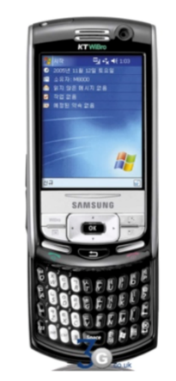
4G Systems
Long Term Evolution (LTE-3GPP2 group)
DL: OFDMA (+high data rate)
UL: Single Carrier Frequency Division Multiple Access (SC-FDMA)
OFDM: Method of digital signal modulation where a single data stream is split across several narrowband channels at different frequencies
15kHz subcarrier spacing for LTE

Slide 32

5G Systems
2019
Based on 4G but introduce new technologies that would all operate under a converged more flexible and adaptable network
Massive MIMO
Millimetre-Wave
Device to device
Communications
Vehicle to vehicle/road
communications
Internet of Things
Software Defined Radios

